Slide 1
IPSec and TLS
Lesson Introduction
IPSec and the Internet key exchange protocol
Transport layer security protocol
Notes:
Headshot

Slide 2

Goals of IPSec
IP spoofing is a common technique in cyber attacks
Bots spoof the an IP address of a victim web site
Then send DNS queries to DNS servers
The DNS servers respond, sending large amounts of data to the victim
Result: a denial-of-service attack
Notes:
A critical weakness of IPv4 is that there is no authentication of the source IP address. That is, if Alice receives a packet with Bob’s source IP address, Alice can not be sure that the packet is really from Bob. In practice, IP spoofing is a common technique used in cyber attacks. For example, bots in a botnet can send a DNS query to DNS servers asking the full TXT record of a domain, by spoofing the source IP address of a victim web site. As a result, the response from the DNS servers, which can amount to a very large volume of data, is sent to the victim web site, resulting in a denial-of-service at the site.

Slide 3
Goals of IPSec
Verify sources of IP packets
Provide Authentication that is lacking in IPv4
Protect integrity and/or confidentiality of packets
Prevent replaying of old packets
Provide security automatically for upper layer protocols and applications
Notes:
IPSec provides security measures at the IP layers, including authentication of source IP addresses, confidentiality and integrity protection of packet data, and authenticity of packet data (preventing replay).
Of course, a network application or protocol can implement its own specific security mechanisms to achieve these goals. By implementing security at the IP level, we can ensure secure networking not only for applications that have security mechanisms but also for the many security-ignorant applications because they all run on top the IP layer.

Slide 4

Spoofing Quiz
Mark the answer(s) that are correct.
IP Spoofing is useful for...
Bidirectional communication
Unidirectional communication
Notes:
QUIZ:
Discuss
---
SOLUTION:
IP spoofing only works for unidirectional communication. For bidirectional communication the server will not reply to the hacker, but to the spoofed IP address, which will not respond appropriately.

Slide 5
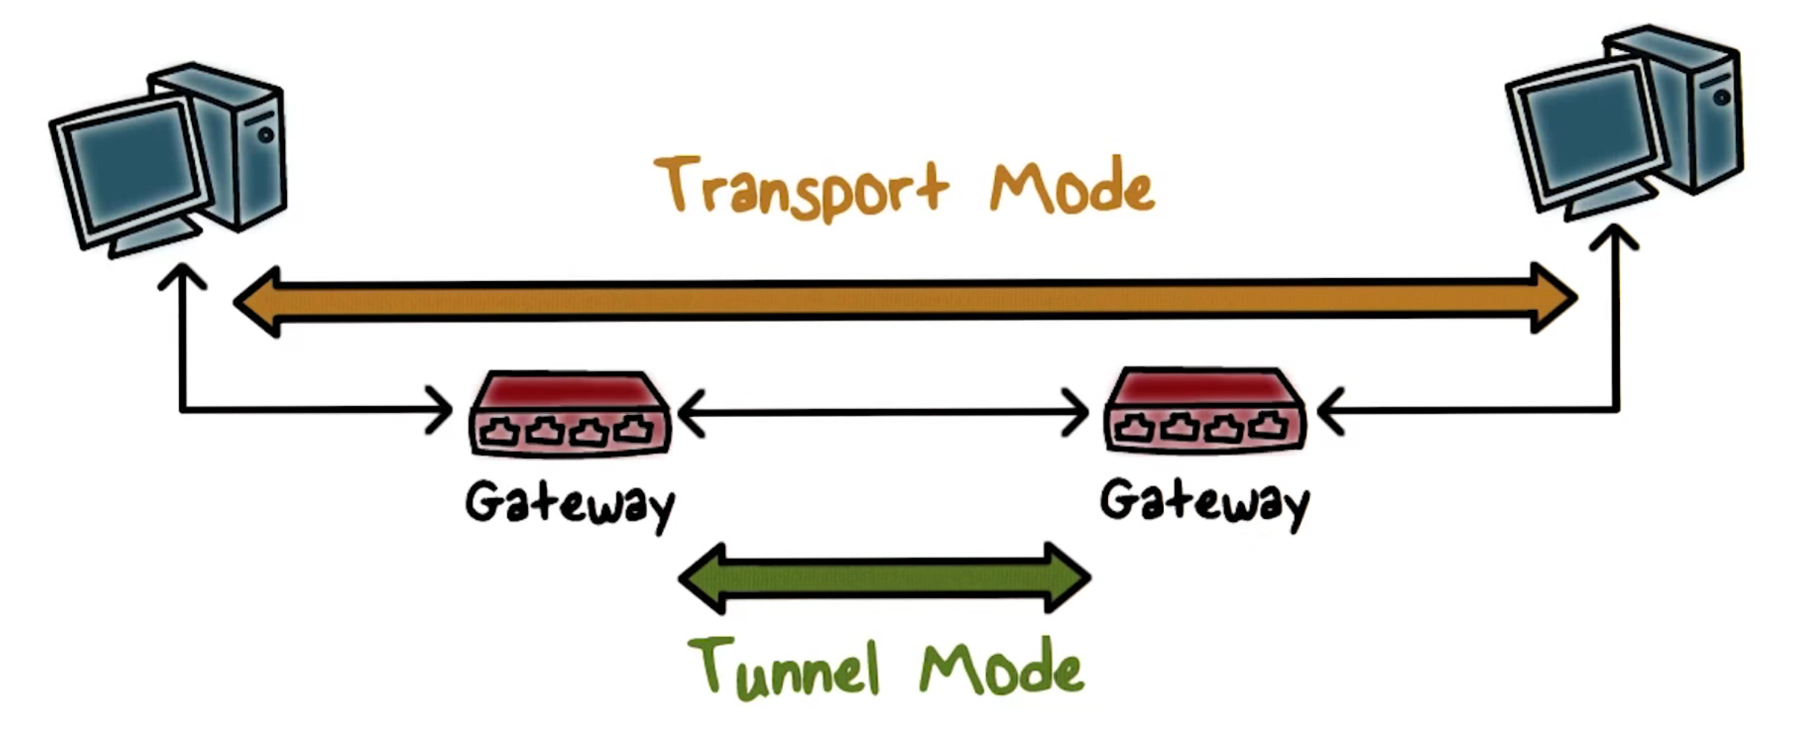
IPSec Modes
Notes:
There are two operation modes in IPSec.
In transport mode, security protection is provided to traffic from one end host to another, so, it is an end-to-end.
In tunnel mode, security protection is typically provided to traffic from the gateway of a network to the gateway of another network. This is how the so-called virtual private network, or VPN, is implemented.

Slide 6
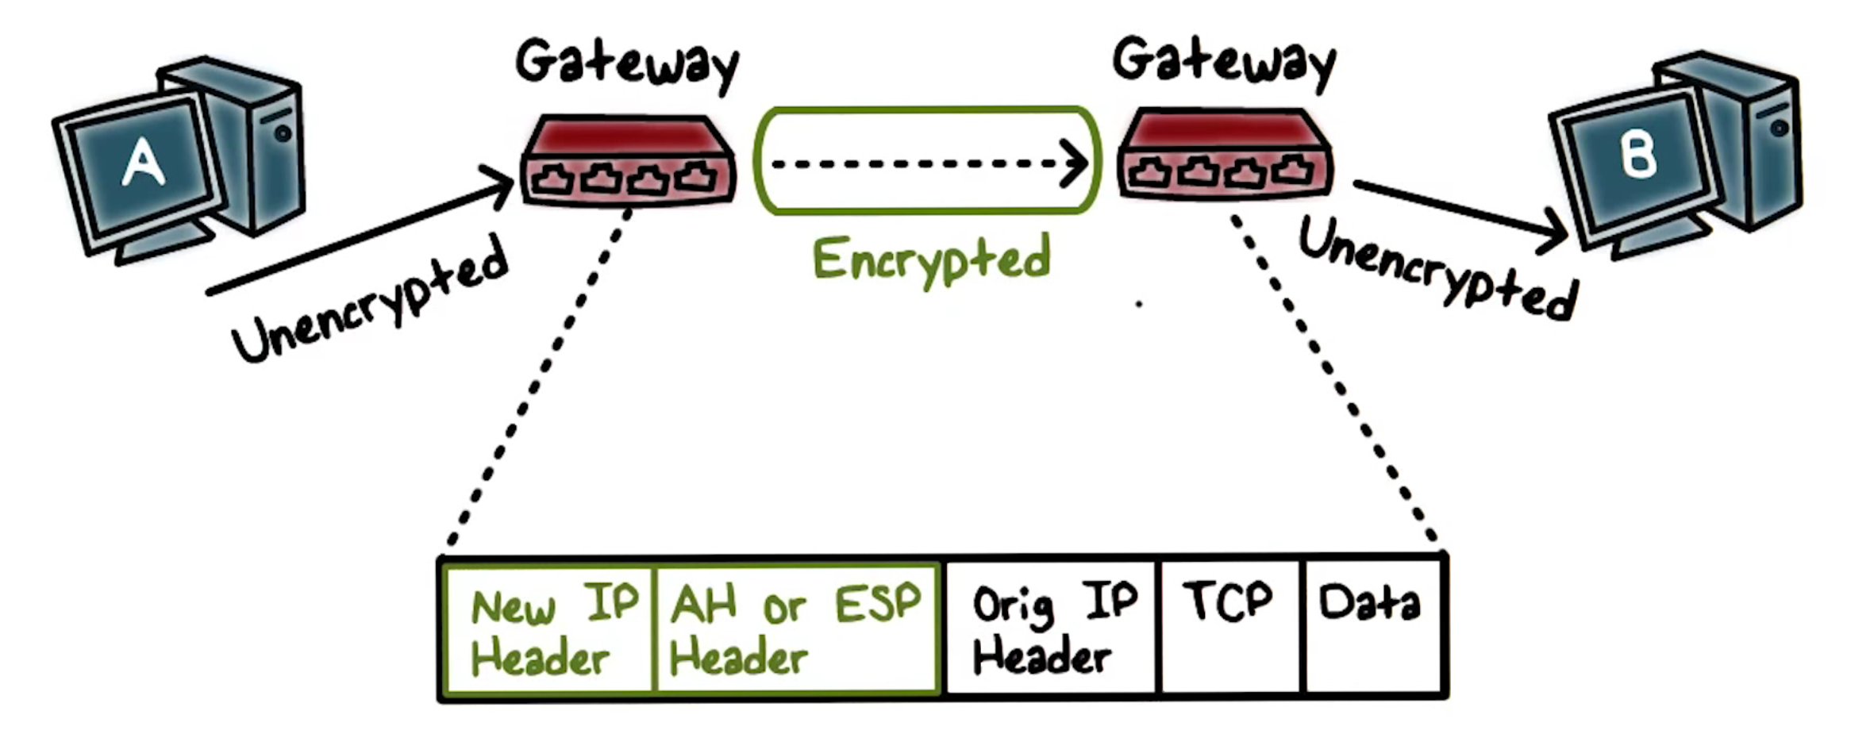
Tunnel Mode
Notes:
Tunnel Mode is the more commonly used operational mode.
-----
Supposed we have two end hosts A and B belonging to the same company but in two different local area networks over the Internet. If there is an IPSec tunnel between the gateways of the two local area networks, then traffic from A to B is automatically protected by the tunnel.
----
That is, A can send unencrypted, or, unprotected packets, and before they leave the local area network, the gateway adds protection, and sends the packets to the gateway to B’s network, which un-processes the packets, for example, decrypts the packets and sends them to B.
-----
The gateway of A’s network actually encapsulates traffic from A to B by adding a new IP header that specifies the gateway as its source IP and B’s gateway as its destination IP to make sure that the protected packet is delivered to B’s gateway first. It also includes the IPSec header, which contains information about the protection provided using AH or ESP, which we will discuss shortly. The original packet becomes the data or payload of the new IP packet.

Slide 7
IPSec Quiz
Fill in the blank with the letter of the correct answer.
IPsec can assure that .
a router advertisement comes from an authorized router
a routing update is not forged
a redirect message comes from the router to which the initial packet was sent
all of the above
Notes:
QUIZ:
Discuss
---
SOLUTION:
Discuss Answer D

Slide 8
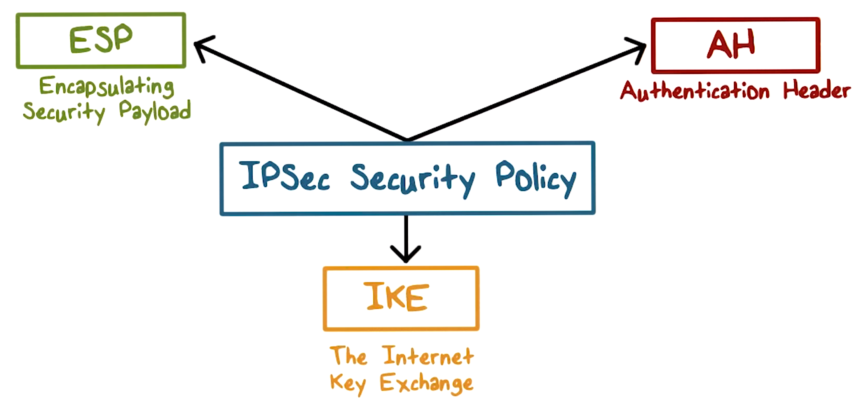
IPSec Architecture
Notes:
Let’s discuss the architecture of IPSec.
The security policy specifies what protection is needed at the IP layer.
The security mechanisms include a key exchange protocol for negotiating protection parameters including cryptographic algorithms and keys, and two types of protections: ESP and AH.

Slide 9
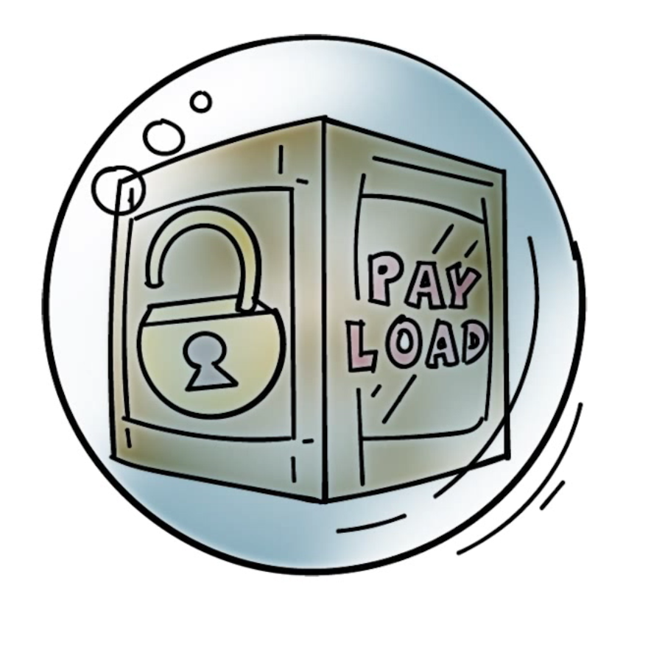
Encapsulated Security Payload (ESP)
Encrypt and authenticate each packet
Encryption is applied to packet payload
Authentication is applied to data in the IPSec header as well as the data contained as payload, after encryption is applied
Notes:
ESP stands for encapsulated security payload.
When ESP is applied, the packet data portion, or, the payload, is encrypted for confidentiality protection. In addition, as an option, message authentication is applied to the encrypted payload and the IPSec header.

Slide 10
ESP Modes Quiz
Mark all answer(s) that are correct.
ESP can be securely used in...
encryption only mode
authentication only mode
encryption and authentication mode
Notes:
QUIZ:
Discuss
---
SOLUTION:
ESP can be used in encryption only and authentication only modes, but it is strongly discouraged. Only using the full encryption and authentication mode is secure.

Slide 11
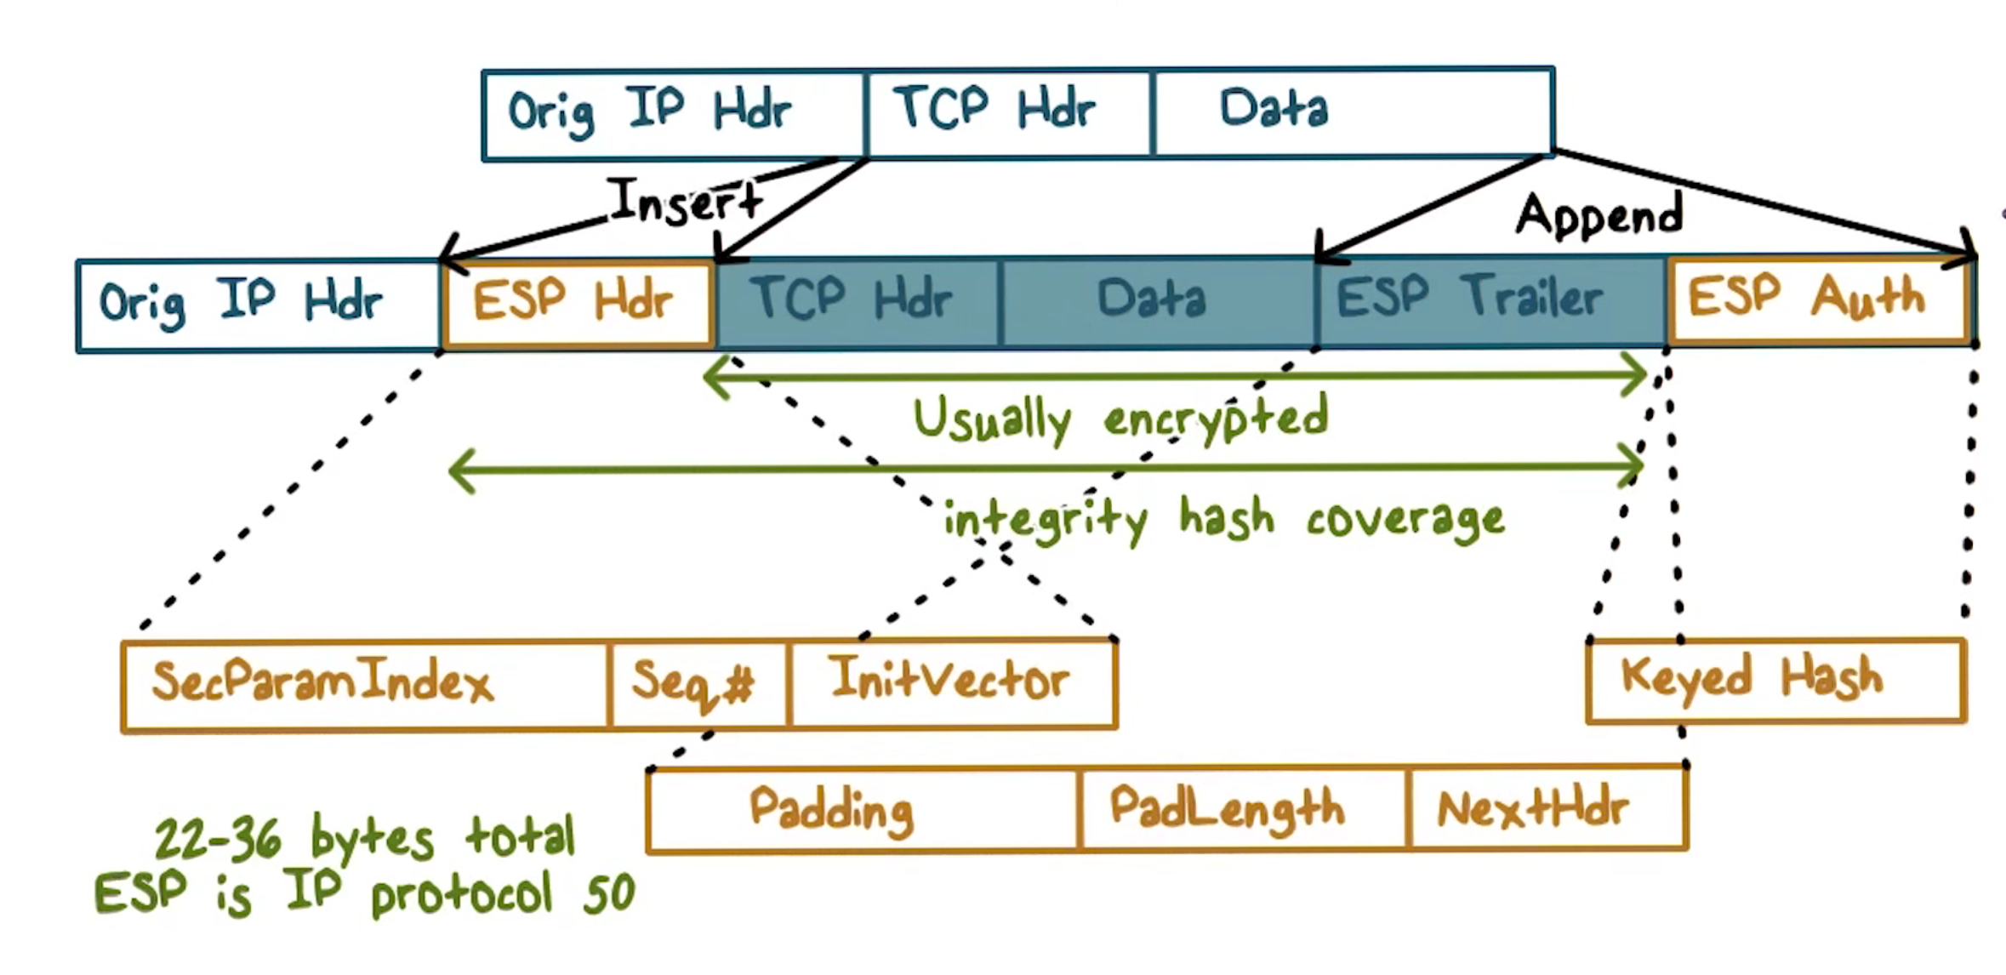
ESP in Transport Mode
Notes:
This shows the new packet layout when IPSec operates in transport mode and uses ESP.
An IPSec header, in this case, the ESP header, is inserted after the original IP header. It includes the security parameter index, a sequence number, and we will discuss these shortly. The ESP header also includes the IV for encryption. The ESP trailer had the padding information and pointer to next header, such as the TCP or UDP header. The packet payload and the ESP trailer are both encrypted but the ESP header is not because it provides information, in particular, the security parameter index, that tells the receiving end how to decrypt the payload, for example, which algorithm and shared secret key to use.
The ESP header and the encrypted payload are then hashed together with a secret key, and the hash value is stored in ESP Auth as the message authentication code for the receiver to verify the authenticity and integrity of the message.

Slide 12
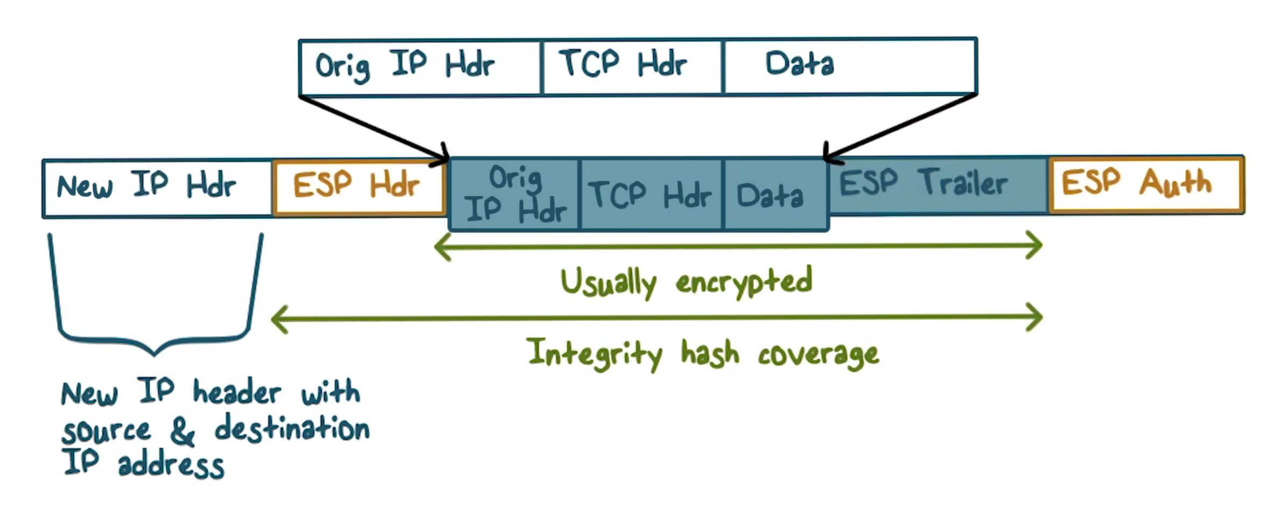
ESP Tunnel Mode
Notes:
If tunnel mode is used, then the ESP header is added after to new IP header, and the packet payload, which now contains the entire original packet plus the ESP trailer, is encrypted. Therefore, even the original IP header data, including the original source and destination IP addresses are encrypted. Similarly, the message authentication code is computed over the entire original packet plus the ESP header and trailer, therefore, even the header of the original IP, for example, the original IP source address, is authenticated.

Slide 13

Authentication Header (AH)
Authentication is applied to the entire packet, with the mutable fields in the IP header “zeroed out”
If both ESP and AH are applied to a packet, AH follows ESP
Notes:
In ESP, the IP header is not authenticated. So what if we want to authenticate the entire packet? We can use Authentication Header, AH.
There are fields in the IP header, e.g., time-to-live, or, TTL, that may change in transmission. The values of these fields are not include, or, zeroed out, when message authentication code is computed.
AH does not encrypt anything. But we can use ESP to encrypt the payload and then apply AH to authenticate the entire packet.

Slide 14
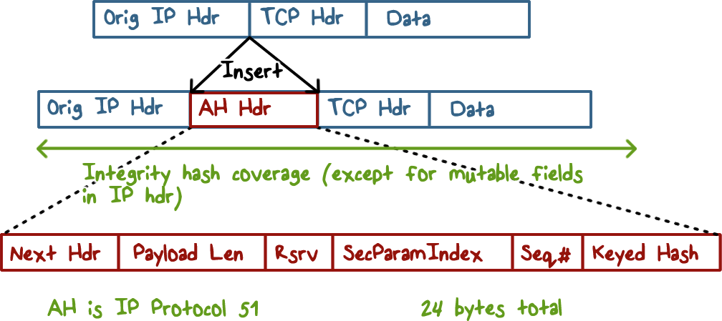
Authentication Header in Transport Mode
Notes:
If AH is used with transport mode, the authentication code is in the AH header, which is inserted after the original IP header. Other important IPSec information in the AH header includes the security parameter index and the sequence number, and again, we will discuss these shortly.

Slide 15
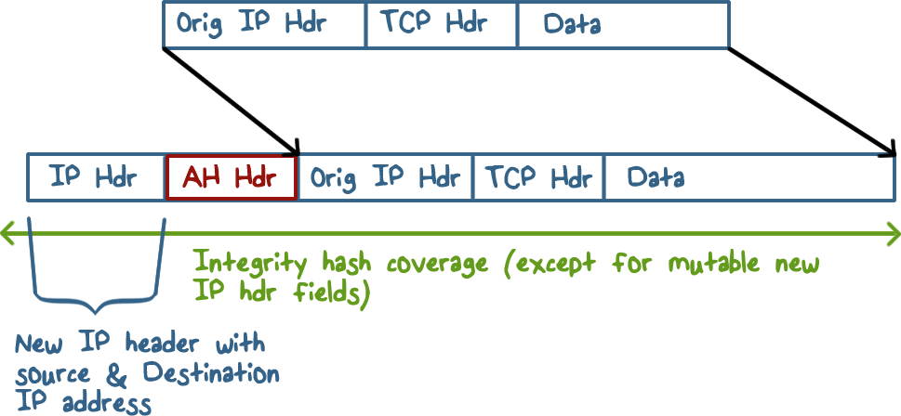
Authentication Header in Tunnel Mode
Notes:
If AH is used with tunnel mode, the AH header is inserted after the new IP header.

Slide 16
ESP and AH Quiz
Label each statement T for True or F For False:
ESP can provide both confidentiality and integrity protection
If the authentication option of ESP is chosen, message integrity code is computed before encryption
To protect the confidentiality and integrity of the whole original IP packet, we can use ESP with authentication option in tunnel mode.
In AH, the integrity hash covers the IP header
Notes:
QUIZ:
Discuss
---
SOLUTION:
Discuss 1. T. 2. F. 3. T. 4. T

Slide 17

Internet Key Exchange
Exchange and negotiate security policies
Establish parameters
Security Associations
Key exchange
Notes:
We have discussed that for two parties to communicate securely, they typically need to use a security protocol that performs mutual authentication and key exchange.
For two end-hosts or two gateways to use IPSec for secure connections over the Internet, the security protocol is the Internet Key Exchange, or, IKE, protocol.
This protocol allows the two parties to decide the security policies for the traffic between them, and agree on a set of security parameters, e.g., AH, or ESP, and which cryptographic algorithms for encryption or hashing.
The protocol also establishes shared keys between the two parties.

Slide 18
Security Association
One-way relationship between a sender and a receiver, defined by IPSec parameters
One SA for inbound traffic, another SA for outbound
Security Association Database (SADB)
Security Parameter Index (SPI)
A unique index for each entry in the SADB
Identifies the SA associated with a packet
Security Policy Database (SPD)
Store policies used to establish SAs
Notes:
The security parameters for a type of traffic, e.g., all http connections from host A to B, are described in a Security Association.
It is asymmetric. For example, for a TCP connection between A and B, we need one SA for traffic from A to B, and another SA for traffic from B to A.
A host will need many SAs, and it uses an SA database to store them, so each SA has a unique index, And this is the security parameter index, or SPI. It is included in an outgoing packet, so that the receiver can use it to look up the SA to unprocess, e.g., decrypt the packet. For example, when A & B agree on the security parameters, both side will store the same SA to describe these parameters, and the unique index for B’s copy of SA is sent to A so that A can store this SPI in its SA. Then when A processes the packet, it uses the parameters defined in this SA and also includes this SPI.
The security parameters define the security mechanisms, and they are determined by security policies, which are stored in a policy database.

Slide 19
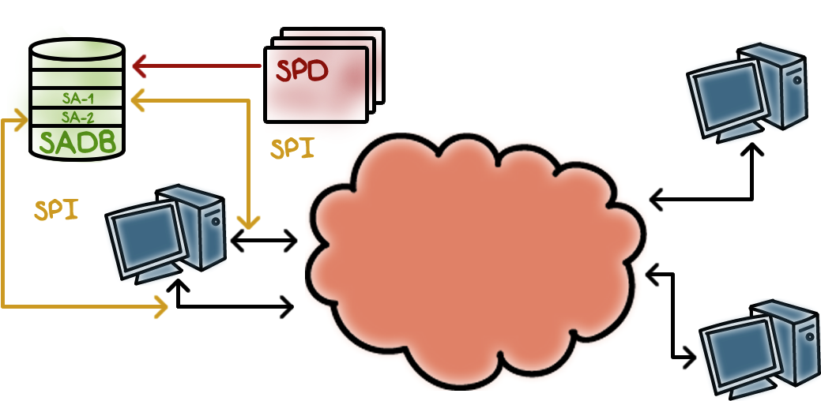
SPD and SADB Fit Together
Notes:
An SPD entry describes the security policy, which decides the security parameters, which are stored in an SA in SADB. The unique index for the SA is the SPI and is included in the IPSec packet header.

Slide 20
SAD and SPD Quiz
Mark all the answer(s) that are true.
SPD and SAD are maintained in separate tables
SAD is searched linearly
SPD is a hash table
Notes:
QUIZ:
Discuss
---
SOLUTION:
Only the first statement is true.
SAD is maintained as a hash table
SPD is searched linearly

Slide 21
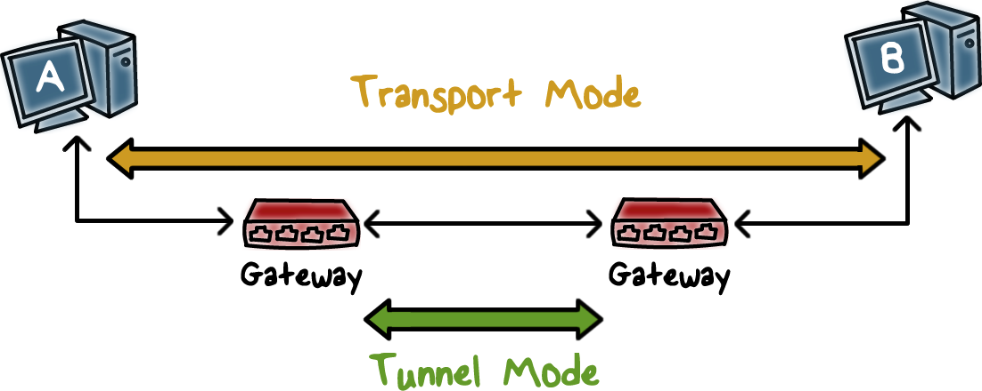
SPD and SADB Example:
Notes:
Let’s discuss an example of SPD and SADB:
Recall the tunnel and transport modes…
Computers A and B wish to communicate with each other.

Slide 22
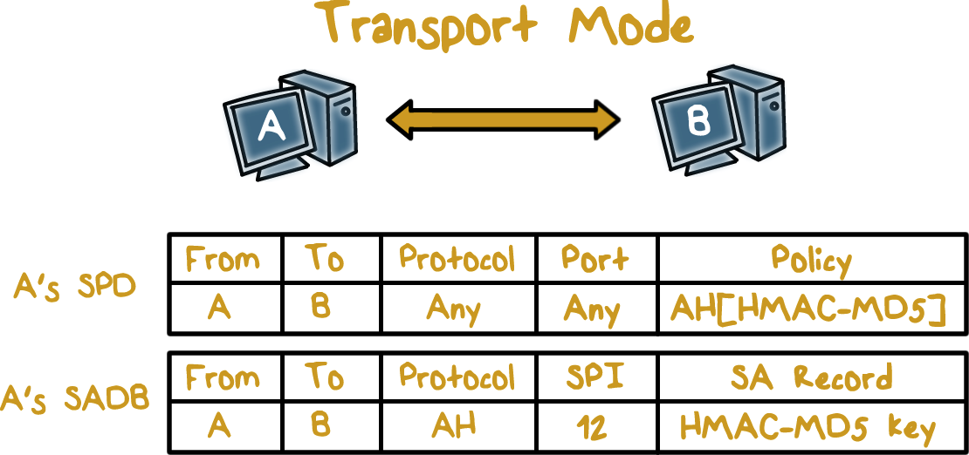
SPD and SADB Example:
Notes:
The end-to-end, or transport mode policy from A to B is to use AH for any traffic, and HMAC with MD5 as the embedded hash function. This is stored in an entry in the SPD. The negotiated parameters are stored in an SA in both A’s and B’s SADB.
For A’s SADB, it stores the secret key for HMAC, and the SPI for looking for the SA in B’s SADB. Then when A sends out traffic to B, it can include this SPI in the IPSec header so that B can use it to look up the SA and unprocess the traffic.

Slide 23
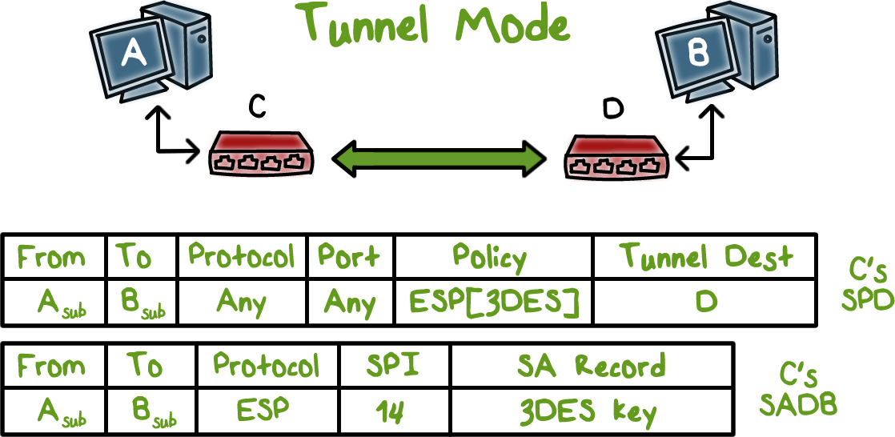
SPD and SADB Example:
Notes:
Similarly, for the tunnel mode traffic from the subnet that A belongs to to the subnet that B belongs to, the policy says that, the destination should be B’s gateway, and it should use ESP and 3DES is requested. Since C is the gateway of the subnet that A belongs to, C’s SPD stores this policy, and its SADB stores the SA that has the 3DES key, and the SPI for looking up the SA in D’s SADB.

Slide 24
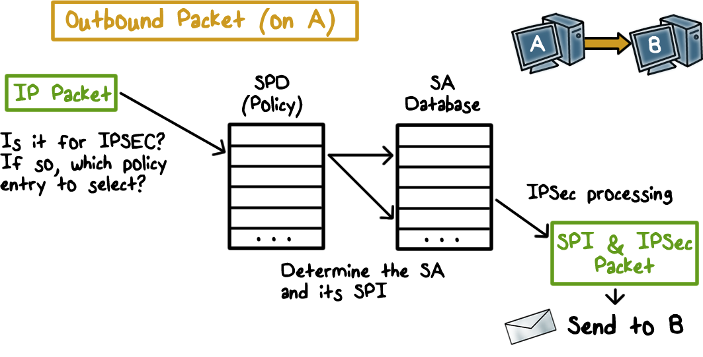
Outbound Processing
Notes:
Here is a figure showing the processing of outbound traffic:
First the SPD is looked up to see if traffic, e.g., http traffic from A to B, needs to be protected, or, to undergo IPSec processing.
If there is a SPD entry, then the SA is looked up in the SADB, and packet is processed according, and the SPI is inserted in the IPSec header.

Slide 25
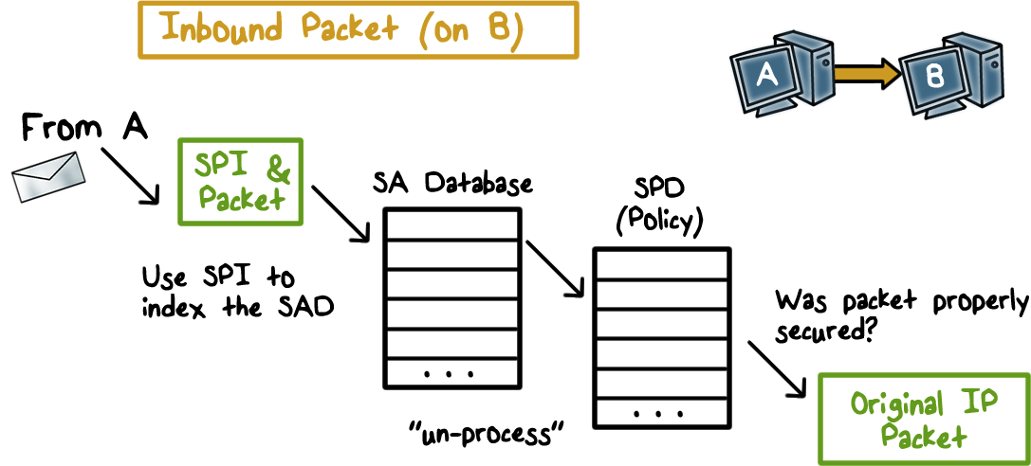
Inbound Processing
Notes:
For inbound traffic,
The SPI in the IPSec header is used to look up the SA in the SADB, and the packet is unprocessed accordingly. Then the SPD is looked up to make sure that the packet had the proper security measures according to the policy. And only then is the packet delivered to the upper layer.

Slide 26

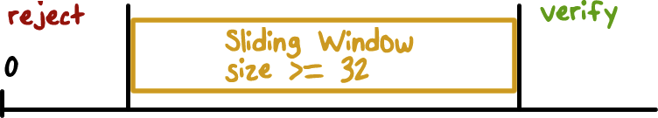
Anti-Replay
Sequence number checking:
Anti-replay is used only if
authentication is selected
Window should not be advanced until the packet has been authenticated
Duplicates are rejected!
Notes:
The IPSec header has an IPSec sequence number designed to prevent replay. It is used only if AH is used or the authentication option is ESP is used. A sliding window of size n, which should be at least 32, is used. That is, although packets may arrive out of order, their sequence numbers should be within the window of size n.
More specifically, when a packet arrives, if its sequence number is smaller than the smallest number of the window, it is rejected. If the number is greater than the largest sequence number of the sliding window, the packet is accepted and the window advances to just cover this number. If the sequence number falls in the window, it is checked to see if the sequence number has been seen before, if yes, it is also rejected; if not, it is accepted and the number is recorded as having been seen.

Slide 27
IPSec Quiz
Label each statement T for True or F For False:
The security association, SA, specifies a two-way security arrangements between the sender and receiver.
SPI is used to help receiver identify the SA to un-process the IPSec packet.
If the sequence number in the IPSec header is greater than the largest number of the current anti-replay window the packet is rejected.
If the sequence number in the IPSec header is smaller than the smallest number of the current anti-replay window the packet is rejected.
Notes:
QUIZ:
Discuss
---
SOLUTION:
1. F. 2. T. 3. F 4. T.

Slide 28

Internet Key Exchange
Used when an outbound packet requires IPSec but does not yet have an SA
Two phases:
Establish an IKE SA
Use the IKE SA to negotiate IPSec SAs
IKE SA used to define encryption & authentication of IKE traffic
Multiple IPSec SAs can be established with one IKE SA
IKE SA bidirectional
Notes:
When A and B require IPSec for traffic between them for the first time, they do not yet have an SA. In other words, they have not yet agreed upon their security parameters, such as encryption and authentication algorithms and keys. They need to negotiate these parameters and store them in an SA. The Internet Key Exchange protocol, or, IKE, is for this purpose.
The protocol works in two phases: the first is to establish an IKE SA because the negotiation of SA should itself be protected. The IKE SA can be used to protect the negotiations of multiple IPSec SAs, and it is bidirectional, that is, it protects SA negotiation traffic from both sides.

Slide 29
IKE Phase I – Create IKE SA
Negotiate protection suite,
crypto algorithms
Establish shared secret
E.g., use Diffie-Hellman
Authenticate the shared secret, IKE SA
E.g., using pre-shared secret key, public-key encryption or digital signatures
Notes:
In IKE phase I, both sides negotiate the protection to be used, e.g., AH or ESP, and agree on the crypto algorithms to use, e.g., AES and HMAC with SHA1.
Then they establish a shared secret, for example, they can use Diffie-Hellman.
To prevent man-in-the-middle, or more generally, to authenticate the shared secret, both sides can use either a pre-shared key or digital signatures.

Slide 30
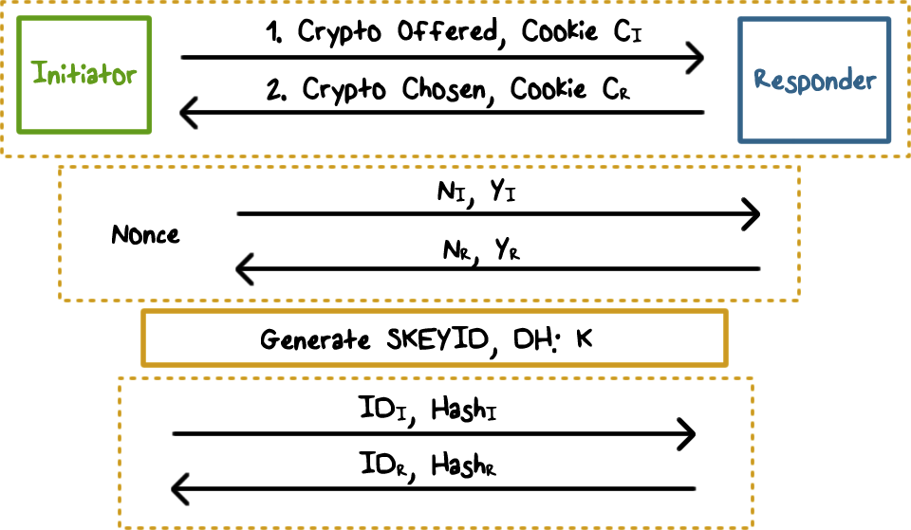
IKE Phase 1 Example
Notes:
Here is an example of IKE Phase I. Both sides have a preshared secret, and they use Diffie-Hellman to establish a new shared key, and use the preshared key to authenticate this newly established shared key. Here is how it works.
First, the initiator sends to the responder the crypto that is proposes to use along with a cookie, which can be easily computed by the initiator and easily verify by the responder, such asf the initiator’s IP address and the current timestamp together. The cookie is used to prove that the initiator has done some computation and is serious about following through the protocol. Cookies in general are used to mitigate denial-of-service attacks where an initiator can send a lot of requests to a responder at no or little cost. The responder sends back its choice of crypto algorithms and its own cookie.
----
Second, the initiator and the responder exchange the public components of the Diffie-Hellman Key Exchange along with their nonce values.
----
Third, both the initiator and responder compute the same shared key according to Diffie-Hellman Key Exchange, and other keys for the IKE SA.
----
Fourth, they then exchange hash values to authenticate the newly established key using their pre-shared secret key. The hash is computed using the information they have exchanged along with the preshared key.

Slide 31
Diffie-Hellman Quiz
The Diffie-Hellman key exchange is restricted to two party communication only.
Is the above statement true or false?
Notes:
QUIZ:
Discuss
---
SOLUTION:
False. More than two parties can use the Diffie-Hellman key exchange to communicate.

Slide 32
Diffie-Hellman and Pre-shared Secret
PRF is a Pseudo-Random Function
SKEYID root secret
=PRF(preshared-key,N_{I}|N_{R})
SKEYID_d for IPSec SA
=PRF(SKEYID,K|C_{I}|C_{R}|0)
K is the shared secret key computed using Diffie-Hellman
SKEYID_a for IKE message data authentication & integrity
= PRF(SKEYID,SKEYID_d|K|C_{I}|C_{R}|1)
SKEYID_e use to encrypt IKE messages
= PRF(SKEYID,SKEYID_a|K|C_{I}|C_{R}|2)
Notes:
Based on the information exchanged between the initiator and responder as well as their pre-shared secret key, they can both compute the following using a pseudo-random function. The PRF can be built using HMAC-SHA-1 to generate a pseudorandom bit stream. Recall that HMAC-SHA-1 takes a message (block of data) and a key of length at least 160 bits and produces a 160-bit hash value. SHA-1 has the property that the change of a single bit of the input produces a new hash value with no apparent connection to the preceding hash value. This property is the basis for pseudorandom number generation.
First, they compute a root secret, SKEYID, using the pre-shared key and the nonce values.
Second, they can compute a shared secret key k according to Difffie-Hellman, a shared key SKEYID_d based the root secret, k, and the cookies. This SKEYID_d can be used to derive keys used in IPSec SAs.
Then the keys for IKE message authentication and encryption are derived.

Slide 33
Authentication of the Key Exchange
To authenticate each other’s identity and data that they just exchanged, the initiator and responder each generates a hash digest that only the other could know
Hash-I=PRF(SKEYID,Y_{I}|Y_{R}|C_{I}|C_{R}|Crypto Offer|ID_{I})
Hash-R=PRF(SKEYID,Y_{R}|Y_{I}|C_{I}|C_{R}|Crypto Offer|ID_{R})
Notes:
Finally, they each computes a hash value using the root secret, which is based on their pre-shared key and the nonce values, and other information they have exchanged including the public messages of the Diffie-Hellman key exchange, the cookies, the crypto information negotiated, and IDs.
Each party can verify the hash computed by the other because the hash values are based on a pre-shared key and the information they just exchanged. Therefore, these hash values can authenticate both parties’ identities and the data that they just exchanged.

Slide 34

IKE-Phase 2 Keys
Default: no PFS (perfect forward secrecy)
Keys for IPSec SA derived from IKE shared secret
With PFS: new nonce values, and new Diffie-Hellman key exchange, etc.
Notes:
The IKE Phase II deals with setting up IPSec SA, which is a one-way association, but multiple IPSec SAs can be negotiated with the protection of the same IKE SA established in Phase I.
The Phase II protocol works very similarly. The difference is in how the IPSec keys are derived. If no perfect forward secrecy is required, then these keys can be derived from one of the shared key, specifically the SKEYID_d computed in Phase I. The weakness is if that key is so how leaked then all the IPSec SAs keys are also leaked.

Slide 35
IKE-Phase 2 Keys with PFS
Each time an IPSec SA is established...
Its keys are created based on the pre-shared key and new, exchanged information
Unless the pre-shared key is compromised, the keys for the current IPSec SA are secure.
Notes:
For stronger security, or, perfect forward secrecy, each time an IPSec SA is established, its keys are created based on the pre-shared key and the new information exchanged, such as the new nonce values, new Diffie-Hellman key exchange, etc. Therefore, unless the pre-shared key, which can be considered the master key, is compromised, the keys for the current IPSec SA are secure even if other keys previously computed have been compromised.

Slide 36
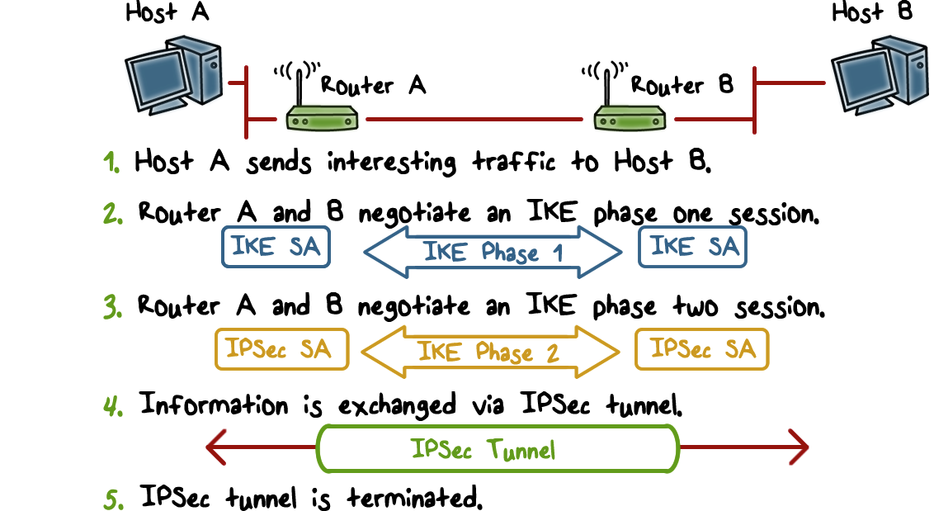
IPSec Summary
Notes:
To summarize, if host A and host B wants to securely communicate, here is the typical workflow:
Assuming that this is the first time that A sends data to B that according to policy requires protection, the router or gateway of A’s network and the router of B’s network use the IKE protocol to first negotiate the IKE SA, then use the IKE SA to negotiate the IPSec SAs.
Then an IPSec tunnel can be created between the routers and the traffic between A to B is protected by the tunnel, e.g., the packet data can be encrypted, and optionally, the header information including the source IP address as well as the packet data can be authenticated.
When A terminates the connection to B, the IPSect tunnel between the two routers also terminates.

Slide 37
IKE Quiz
Label each statement T for True or F For False:
An IKE SA needs to established before IPSec SAs can be negotiated
The identity of the responder and receiver and the messages they have exchanged need to be authenticated
With perfect forward secrecy, the IPSec SA keys are based on the IKE shared secret established in Phase I.
Notes:
QUIZ:
Discuss
---
SOLUTION:
1. T 2. T 3. F

Slide 38
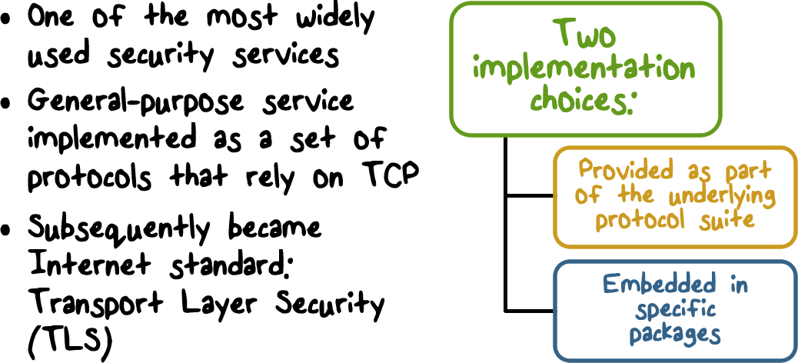
Secure Socket Layer (SSL) and Transport Layer Security (TLS)
Notes:
One of the most widely used security services is the Secure Sockets Layer (SSL) and the follow-on Internet standard known as Transport Layer Security (TLS). TLS has largely supplanted earlier SSL implementations. TLS is a general-purpose service implemented as a set of protocols that rely on TCP. At this level, there are two implementation choices. For full generality, TLS could be provided as part of the underlying protocol suite and therefore be transparent to applications. Alternatively, TLS can be embedded in specific packages.
For example, most browsers come equipped with SSL, and most Web servers have
implemented the protocol.

Slide 39
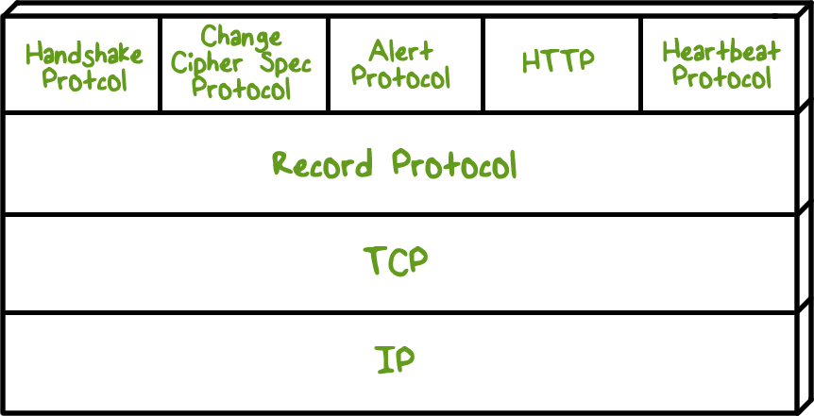
Secure Socket Layer (SSL) and Transport Layer Security (TLS)
Notes:
TLS is designed to make use of TCP to provide a reliable end-to-end secure service.
TLS is not a single protocol but rather two layers of protocols, as illustrated in this Figure.
The Record Protocol provides basic security services to various higher-layer
protocols. In particular, the Hypertext Transfer Protocol (HTTP), which provides
the transfer service for Web client/server interaction, can operate on top of TLS.
Three higher-layer protocols are defined as part of TLS: the Handshake Protocol,
the Change Cipher Spec Protocol, and the Alert Protocol. These TLS-specific protocols
are used in the management of TLS exchanges.

Slide 40
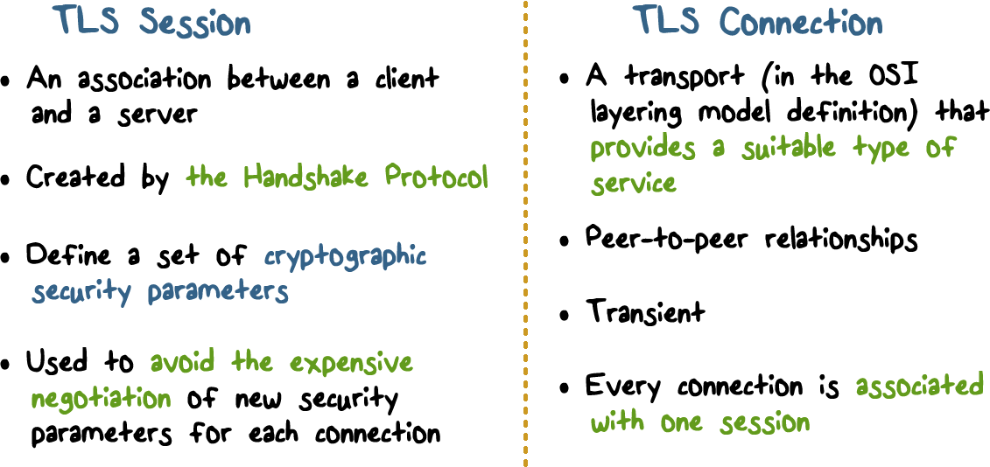
TLS Concepts
Notes:
Two important TLS concepts are the TLS session and the TLS connection,
which are defined in the specification as follows:
• Connection : A connection is a transport (in the OSI layering model definition)
that provides a suitable type of service. For TLS, such connections are peer-to-
peer relationships. The connections are transient. Every connection is
associated with one session.
• Session : A TLS session is an association between a client and a server. Sessions
are created by the Handshake Protocol. Sessions define a set of cryptographic
security parameters, which can be shared among multiple connections.
Sessions are used to avoid the expensive negotiation of new security
parameters for each connection.
Between any pair of parties (applications such as HTTP on client and
server), there may be multiple secure connections. In theory, there may also be
multiple simultaneous sessions between parties, but this feature is not used in
practice.

Slide 41
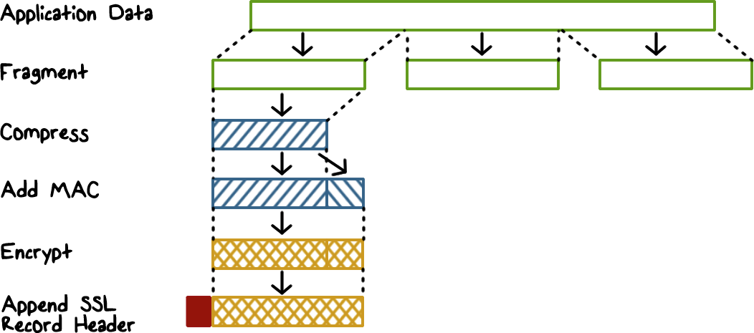
SSL Record Protocol
Notes:
The SSL Record Protocol provides two services for SSL connections:
• Confidentiality: The Handshake Protocol defines a shared secret key that is
used for symmetric encryption of SSL payloads.
• Message integrity: The Handshake Protocol also defines a shared secret key
that is used to form a message authentication code (MAC).
This figure shows the overall operation of the SSL Record Protocol. The
first step is fragmentation . Each upper-layer message is fragmented into blocks. Next, compression is optionally applied. The next
step in processing is to compute a message authentication code over the compressed
data. Next, the compressed message plus the MAC are encrypted using symmetric
encryption.
The final step of SSL Record Protocol processing is to prepend a header,
which includes version and length fields.
The content types that have been defined are change_cipher_spec, alert,
handshake, and application_data. The first three are the SSL-specific protocols,
discussed next. Note that no distinction is made among the various applications
(e.g., HTTP) that might use SSL; the content of the data created by such applications
is opaque to SSL.
The Record Protocol then transmits the resulting unit in a TCP segment.
Received data are decrypted, verified, decompressed, and reassembled, and then
delivered to higher-level users.

Slide 42

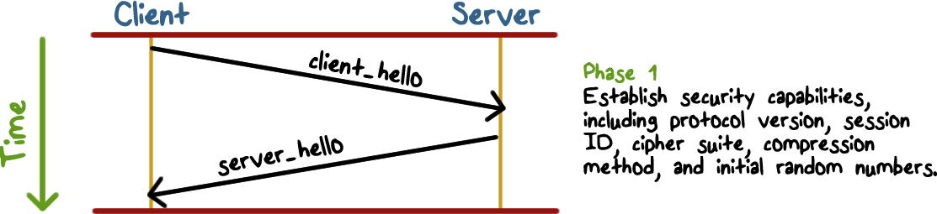
The Handshake Protocol
Notes:
The Handshake Protocol consists of a series of messages exchanged by client
and server.
This figure shows the initial exchange needed to establish a logical
connection between client and server. The exchange can be viewed as having
four phases.
Phase 1 is used to initiate a logical connection and to establish the security
capabilities that will be associated with it. The exchange is initiated by the client,
which sends a client_hello message with the following parameters:

Slide 43
The Handshake Protocol
The Parameters:
Version: the highest TLS version understood by the client
Random: a 32-bit timestamp and 28 bytes generated by a secure random number generator
Session ID: a variable-length session identifier
CipherSuite: a list containing the combinations of cryptographic algorithms supported by the client
Compression Method: a list of compression methods supported by the client
Notes:
• Version: The highest TLS version understood by the client.
• Random: A client-generated random structure, consisting of a 32-bit timestamp
and 28 bytes generated by a secure random number generator. These
values are used during key exchange to prevent replay attacks.
• Session ID: A variable-length session identifier. A nonzero value indicates
that the client wishes to update the parameters of an existing connection or
create a new connection on this session. A zero value indicates that the client
wishes to establish a new connection on a new session.
• CipherSuite: This is a list that contains the combinations of cryptographic
algorithms supported by the client, in decreasing order of preference. Each
element of the list (each cipher suite) defines both a key exchange algorithm
and a CipherSpec.
• Compression method: This is a list of the compression methods the client
supports.
After sending the client_hello message, the client waits for the server_hello
message, which contains the same parameters as the client_hello message.

Slide 44
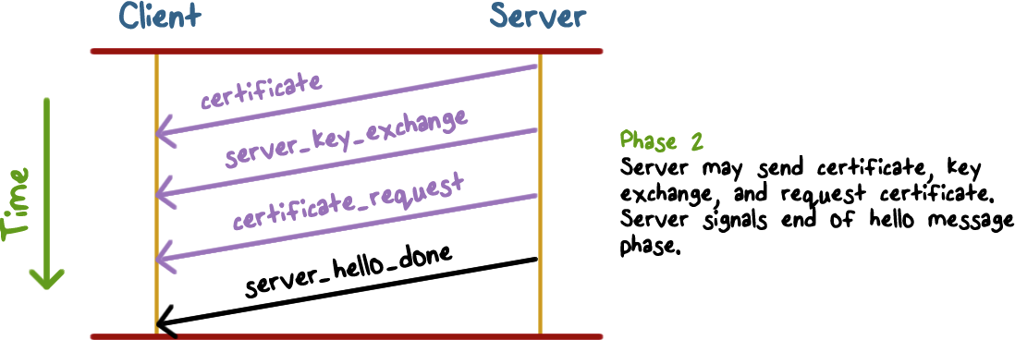
The Handshake Protocol
Notes:
The details of phase 2 depend on the underlying public-key encryption scheme
that is used. In some cases, the server passes a certificate to the client, possibly additional
key information, and a request for a certificate from the client.
The final message in phase 2, and one that is always required, is the server_done
message, which is sent by the server to indicate the end of the server hello and associated
messages. After sending this message, the server will wait for a client response.

Slide 45
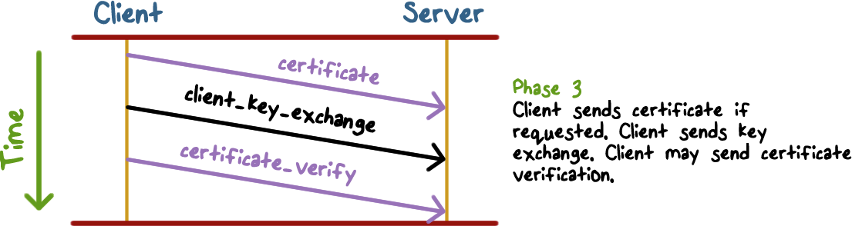
The Handshake Protocol
Notes:
In phase 3 , upon receipt of the server_done message, the client should verify
that the server provided a valid certificate if required and check that the server_
hello parameters are acceptable. If all is satisfactory, the client sends one or more
messages back to the server, depending on the underlying public-key scheme.

Slide 46
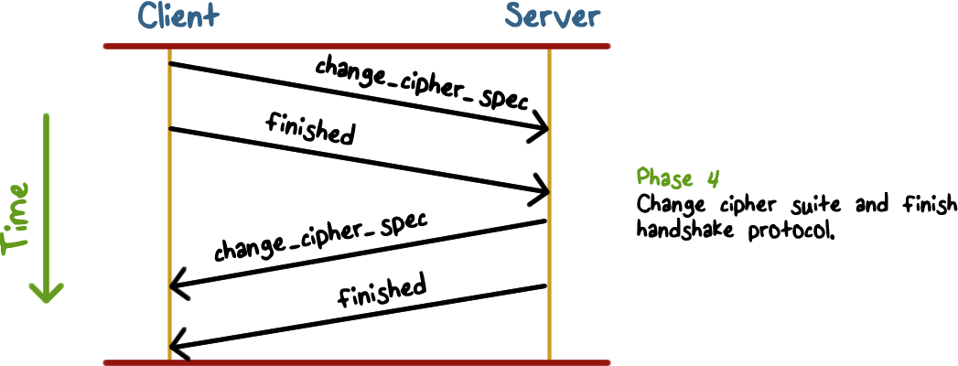
The Handshake Protocol
Notes:
Phase 4 completes the setting up of a secure connection. The client sends a
change_cipher_spec message and copies the pending CipherSpec into the current
CipherSpec. Note that this message is not considered part of the Handshake Protocol
but is sent using the Change Cipher Spec Protocol. The client then immediately
sends the finished message under the new algorithms, keys, and secrets. The finished
message verifies that the key exchange and authentication processes were successful.
In response to these two messages, the server sends its own change_cipher_spec
message, transfers the pending to the current CipherSpec, and sends its finished
message. At this point, the handshake is complete and the client and server may
begin to exchange application layer data.

Slide 47
IPSec and TLS
Lesson Summary
IPSec can operate in tunnel or transport mode
Confidentiality and authenticity protection provided through ESP and AH
The one-way security association stores security parameters.
SSL/TLS has two layers: record protocol, and handshake, change cipher spec and alert protocols
Notes:
Headshot

